Slide 1
100%- Dating Application
Susana Lainez, Amy Abraham, Nguyen Le, Orlando Garcia, Soumaya Hajji, Daniel Arrant, James Ostlind

Slide 2
OBJECTIVE
We created a dating application that pairs users using common interests
Based on how many common interests a person has with another individual, a person is assigned a compatibility ratio from 0% to 100%
Questions involving common books, movies, tv shows, music, hobbies, etc. will be asked when the user starts a profile
As users start swiping through potential matches, they will see how compatible (percentage-wise) they are with other individuals on the application
Filters such as distance, religion, occupation,etc. will also be available for users

Slide 3
SIMILAR DESIGNS
Tinder
Swipe left and right
Bumble
Woman must initiate conversation
OkCupid
Percentile score
Grindr
LGBTQ+ community
Our dating app, 100%, is very much a combination of Tinder and OkCupid. Like OkCupid, our app provides a percentage of compatibility between two users. Like Tinder, once users see another’s account and percentage, they can swipe if they like them or not (up for yes, down for no).
Notes:
By doing some research, we found out that there are a multitude of different dating applications. The most popular ones are Tinder, Bumble, OkCupid, and Grindr. Tinder lets each user create a profile with up to 500 characters and 6 images. When looking for matches, Tinder shows a user another user’s profile and allows them to either swipe right, meaning they like them, or swipe left, meaning they are not interested. A user can also use a super like to show the other user that they really like them. Tinder has a free version that only allows limited swipes however. For unlimited swipes, users will have to pay a monthly fee. Bumble is very similar to Tinder in the form of profile and selection set up. However, different to Tinder, if a man and woman match up with each other, the woman has to message first. OkCupid lets users create a large profile, rather than a concise one. Users can answer questions as well as what answer you would like your potential match to be. The app then creates a percentile score that shows compatibility between users. Grindr is a dating app specifically for the LGBTQ+ community. The app also allows users to specify what they are looking for, such as finding love, making friends, or just a casual hookup.
Our dating app, 100%, is very much a combination of Tinder and OkCupid. Like OkCupid, our app provides a percentage of compatibility between two users. Like Tinder, once users see another’s account and percentage, they can swipe if they like them or not (up for yes, down for no).

Slide 4
COST ESTIMATION:
HARDWARE PRODUCTS
Backend and Servers: AWS Cloud Services ($300 - $700 per month)
Development: 4 MacBook Pros ($12,100)
Estimated First Year Cost: $15700 - $20500
Estimated Cost After First Year: $3600 - $8400

Slide 5
COST ESTIMATION:
SOFTWARE PRODUCTS
Development Tools: JetBrains All Products Pack ($649 1st year, $519 2nd year, $389 afterwards), Fluid UI Team ($500 per year)
Developer Memberships: Apple Developer Program ($99 per year), Google Play Developer Program ($25 one time)
Project Management Tools: Trello Business Class ($70 per month)
Estimated First Year Cost: $2112
Estimated Cost After First Year: $1977

Slide 6
COST ESTIMATION:
PERSONNEL
Leadership Personnel: 1 Team Lead, 2 Team Coordinators
Coding Personnel: 2 Programmers, 1 Lead Programmer
Design Personnel: 1 Lead Designer
Total Cost of Personnel: None

Slide 7
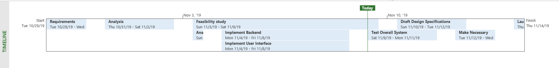
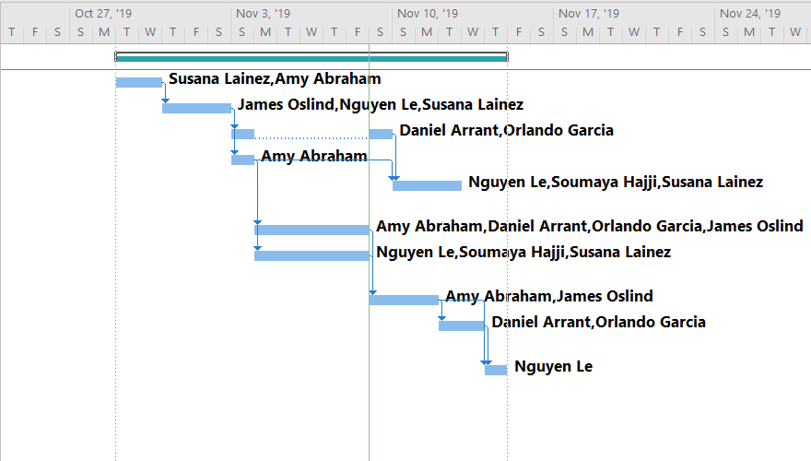
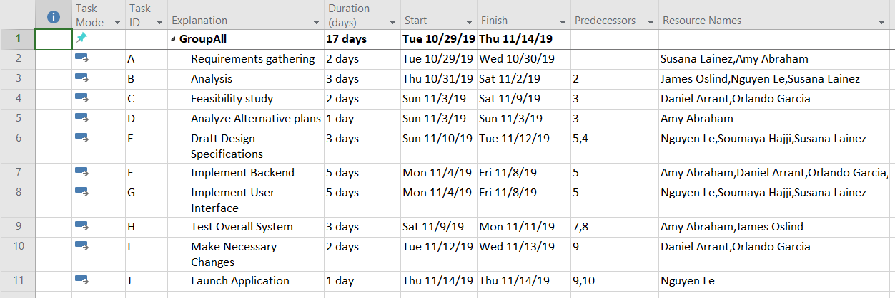
PROJECT TIMELINE
Activity Bar Chart:
Task Table:

Slide 8
FUNCTIONAL & NON-FUNCTIONAL REQUIREMENTS
Functional Requirements
Matches users based on mutual interests.
It allows users to swipe through people with similar interests.
Gives a 1-100 compatibility percentage between two users.
Will allow interaction between matched users through messaging.
Users will swipe up if they’re interest or down if they’re not interested.
Non-Functional Requirements
Product Requirements
Efficiency Requirements
Performance Requirements
App must load matches within 10 seconds.
App must evaluate compatibility percentage in 3 seconds or less.
Space Requirements
App shall not exceed 200MB of space on a user’s phone.

Slide 9
Organizational Requirements
Environmental Requirements
App will run Apple’s iOS and Google’s Android mobile operating systems.
Operational Requirements
Users will choose a username and password to access their accounts.
User will be able to add data to their profile in the form of pictures, biographies, and interests.
Users will be able to send messages to matched users through a messaging interface on the application.
Development Requirements
Android app will be built and maintained using IntelliJ IDE using Java, iOS app will be built and maintained using Xcode IDE using Swift.
External Requirements
Regulatory Requirements
No users below the age of 18.
Ethical Requirements
Must discourage the exchange of inappropriate messages between users on the app.

Slide 10
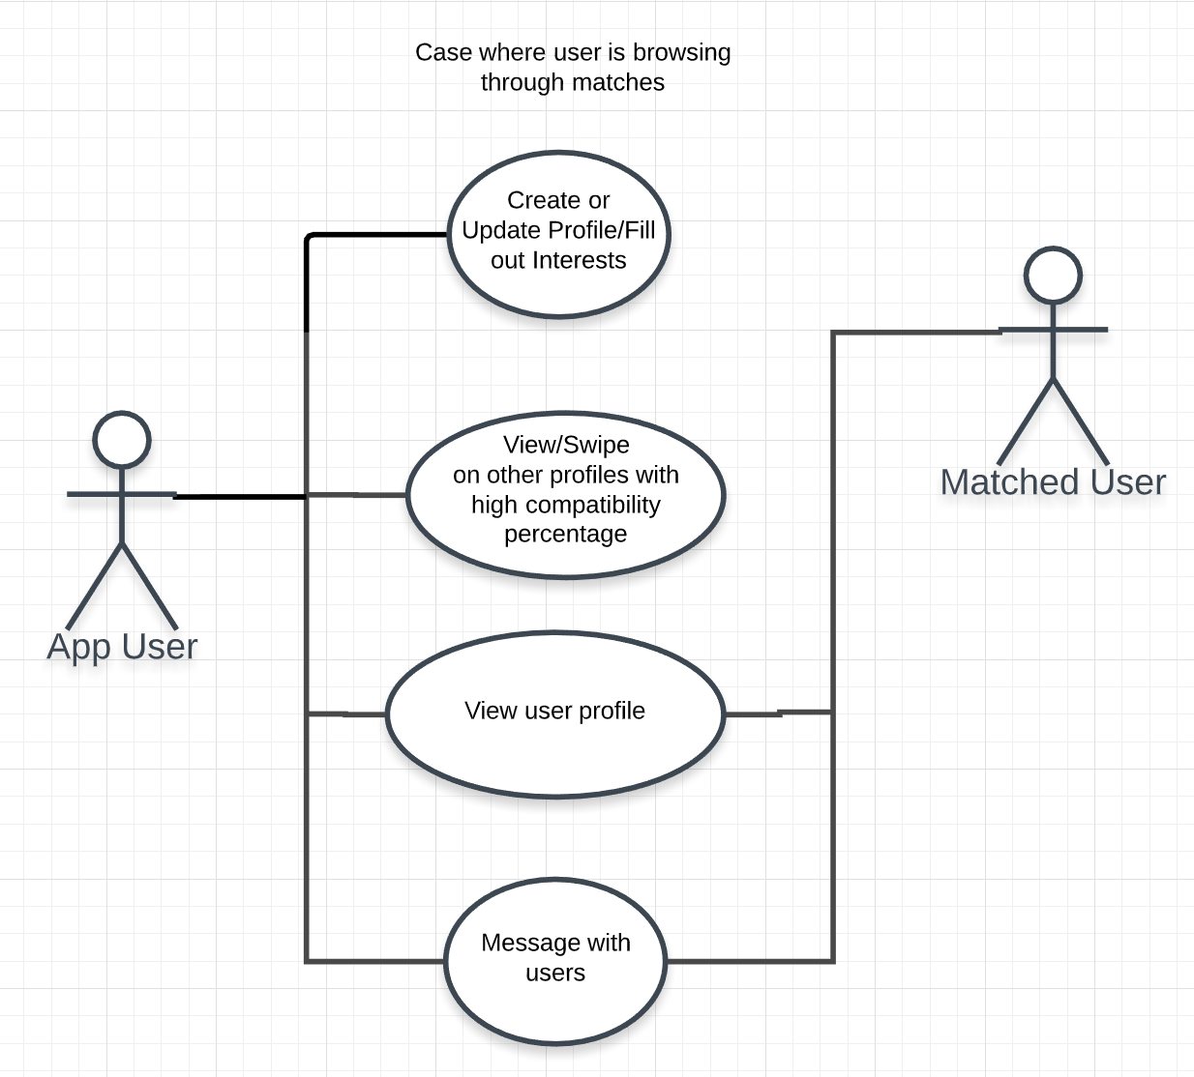
USE CASE DIAGRAM

Slide 11
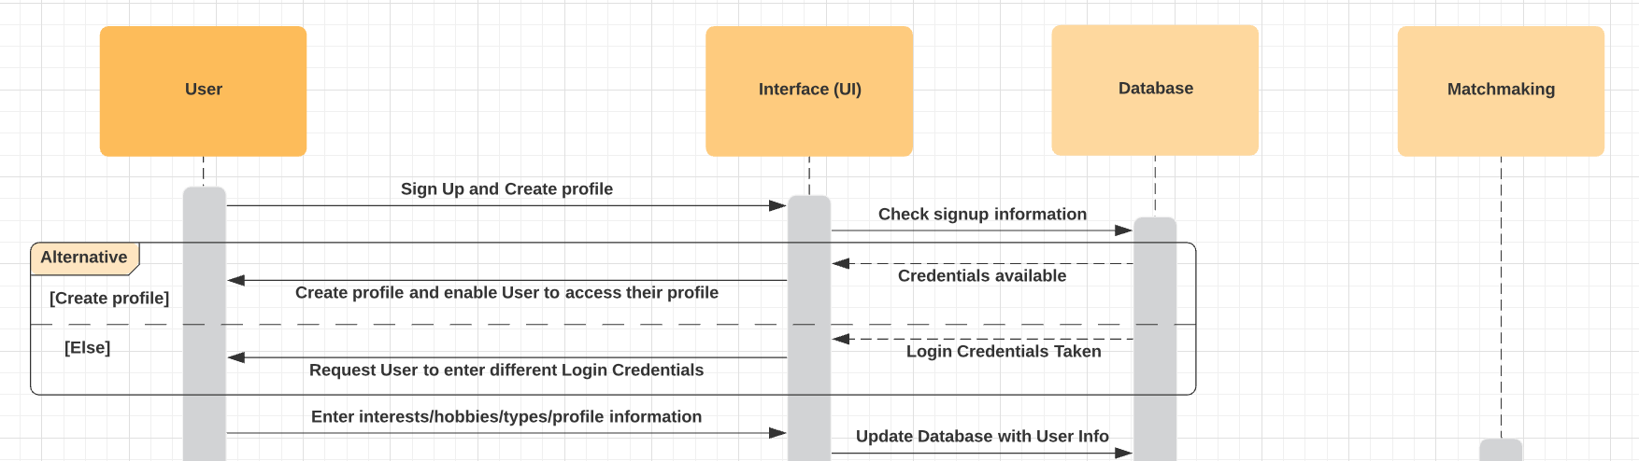
SEQUENCE DIAGRAM
Create profile/Fill out interests

Slide 12
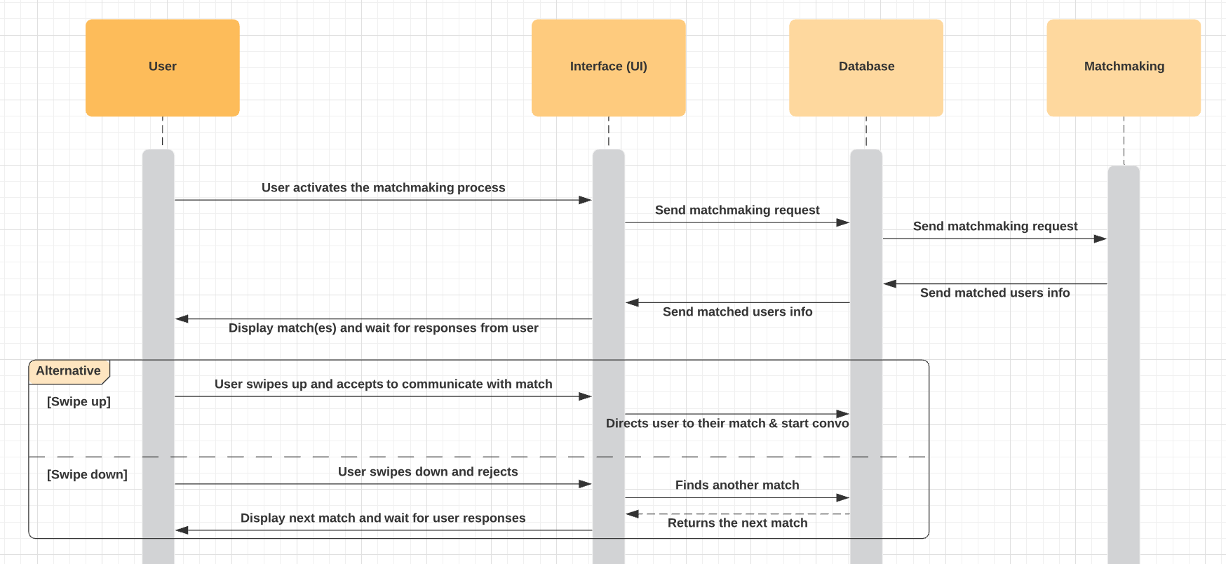
SEQUENCE DIAGRAM
Matchmaking

Slide 13
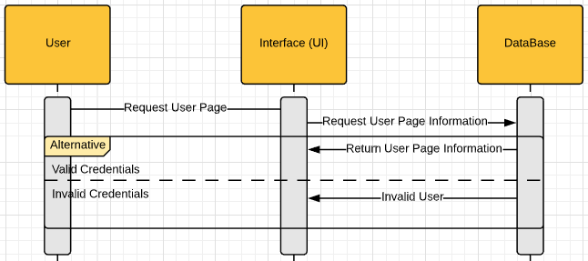
SEQUENCE DIAGRAM
View user profile:

Slide 14
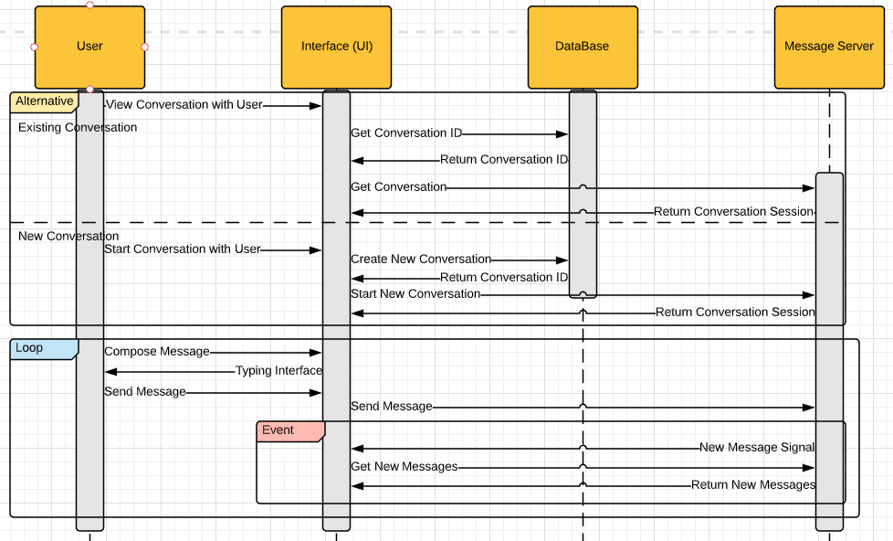
SEQUENCE DIAGRAM
Message with users:

Slide 15
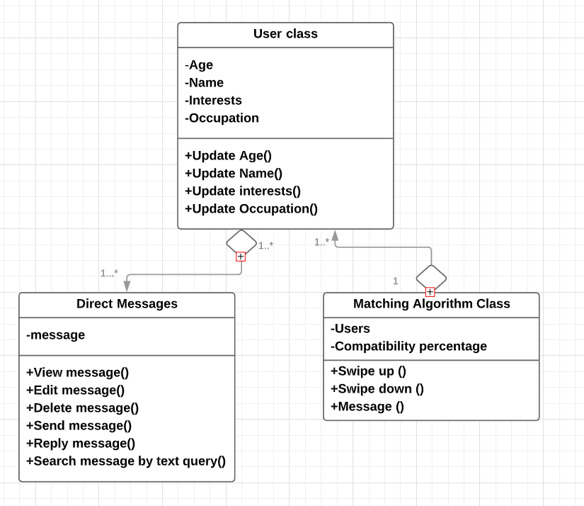
CLASS DIAGRAM

Slide 16
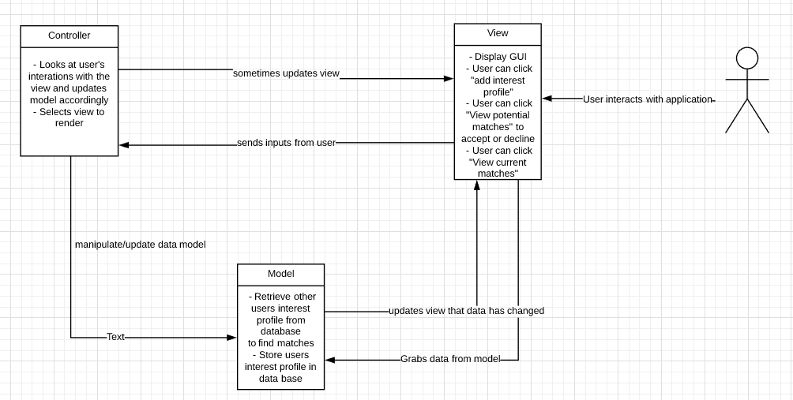
ARCHITECTURAL DESIGN-
MODEL VIEW CONTROLLER (MVC) PATTERN
Notes:
The architectural pattern we will use is MVC because changes to system data, presentation of the data, and how the user interacts with the data all correlate and work together for a software application. For our dating app, user interaction is extremely important and MVC takes into account user interaction and adjusts data and the presentation of the data on the app. It is a simple pattern that is seen used in many software that allows for changes and easily shows the interactions between components in software.

Slide 17
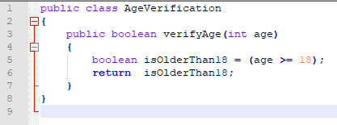
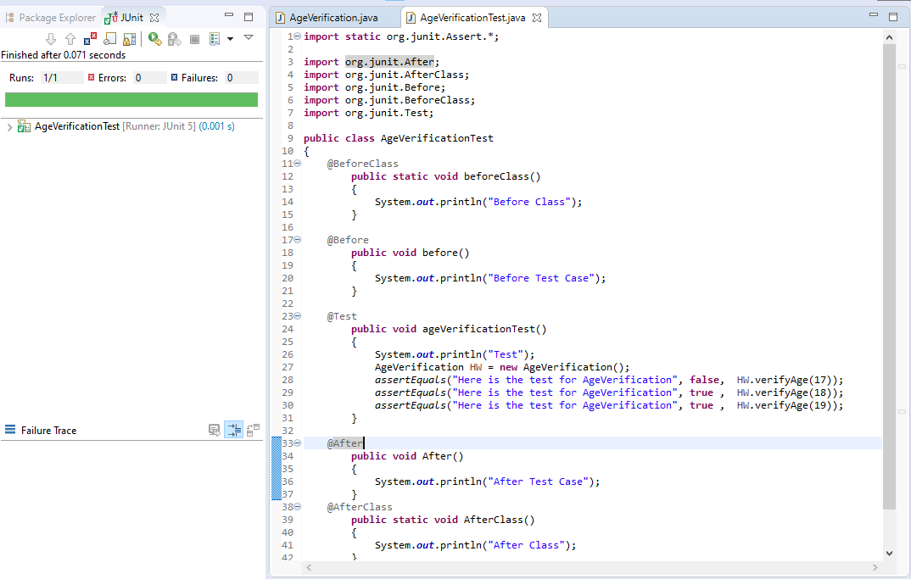
JUNIT
The software system needs to be able to verify that the user’s age is above or equal to the minimum required age of 18. The code includes the method “verifyAge(int age)” which takes in the user’s age and returns true if their age is 18 or above, and returns false otherwise.

Slide 18
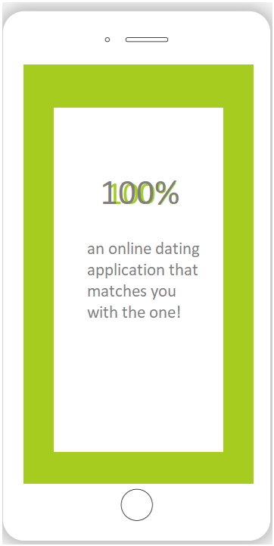
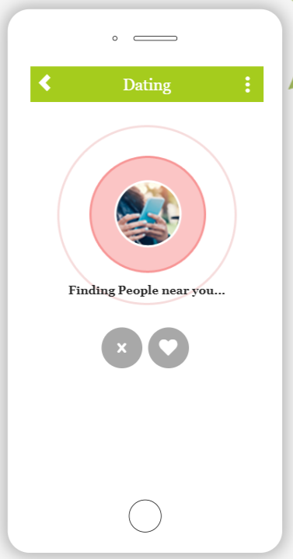
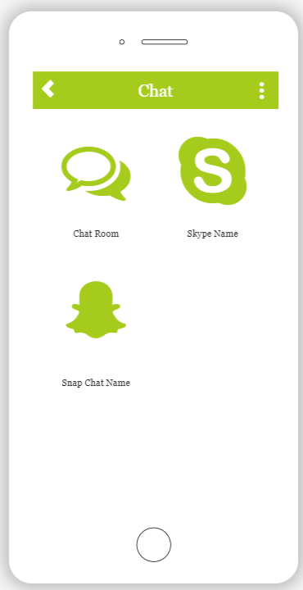
DEMO OF THE THE USER INTERFACE DESIGN

Slide 19
CONCLUSION
Our app implements the latest in machine learning technology to match users based on their interests and personalities. The app employs a small but functional set of interface controls allowing users to easily interact with our app and find the partner they’ve been looking for.
We have taken all considerations into account and plan on developing our app to fit with all relevant rules and guidelines. As well, we have set benchmarks and expectation for application performance characteristics and user interface design to ensure a pleasant user experience.

Slide 20
REFERENCES
[1] Apple Inc, “App Store Review Guidelines,” App Store Review Guidelines - Apple Developer,
12-Sep-19AD. [Online]. Available: https://developer.apple.com/app-store/review/guidelines/. [Accessed: 18-Oct-2019].
[2] M. Jansen, “Looking for Love or Just Some Fun? Cozy up with the Best Dating Apps of
2019.” Digital Trends, 17 Oct. 2019. [Online] Available: ww.digitaltrends.com/mobile/best-dating-apps/. [Accessed on: 17 Oct. 2019]
[3] “Date, Meet, Network Better,” Bumble. [Online]. Available: https://bumble.com/en/.
[Accessed: 17-Oct-2019].
[4] “Developer Policy Center,” Google. [Online]. Available:
https://play.google.com/about/developer-content-policy/. [Accessed: 18-Oct-19]
[5] “Find the people you've crossed paths with,” happn. [Online]. Available:
https://www.happn.com/en/. [Accessed: 17-Oct-2019].
[6] “Match. Chat. Date.,” Tinder. [Online]. Available: https://tinder.com/?lang=en. [Accessed:
17-Oct-2019].

Slide 21
REFERENCES
[7] OkCupid, “Free Online Dating,” OkCupid. [Online]. Available: https://www.okcupid.com/.
[Accessed: 17-Oct-2019].
[8] M. Jansen, “Looking for love or just some fun? Cozy up with the best dating apps of 2019,”
Digital Trends, 06-Nov-2019. [Online]. Available:
https://www.digitaltrends.com/mobile/best-dating-apps/. [Accessed: 09-Nov-2019].
[9] “Enter Business Name (You Can Change It Later).” App Maker | Free App Creator | Mobile
App Builder Online, https://snappy.appypie.com/appbuilder/creator-software/build.

